Slide 1
External factors
Decision process
Relevant theory
Environment
Weather conditions
Other vessels
Waterway
Mental model
Identify situation
Predict future states
Action
Strategy
Execute
Evaluate
Identify
Evaluate
Decide
Update mental model
Mitigate risk
Sensors
Information
Static hazards
Relevant objects
Dynamic hazards
Own manouvrability
Safe motion parameters
Filter situation
Hazard criteria
Routeplanning criteria
Knowledge
PART I & Appendix
Simulation environment
Communication
Data exchange
Environment
Decisions
Emergency
Hydrodynamics
PART III
Protocol
Manouvring requirements
PART II
Result

Slide 2
Mental model
Identify situation
Predict future states
Action
Strategy
Result

Slide 3
L
0.75L
1.1L
5L
2.5L

Slide 4
Identify situation
Passing
Crossing
Take-over
Merge
Predict future states
CPA
Crossing distance
Strategy
Increase CPA by yourself
Action
Continue without change
Evasive manoeuvrer
Adjust speed
Emergency stop
Communicate
Result
CPA
Perceived risk
Safe situation
Increase crossing distance
Work together with others
Emergency
Follow planned path
Notes:
Continue without change & Do not change speed or rudder\\
Evasive manoeuvrer & Steer to starboard or port side first and end at same course\\
Adjust speed & Reduce speed or speed-up \\
Emergency stop & Turn ship side-ways and set propulsion in reverse\\
Communicate & Discuss required actions with other vessel(s)\\

Slide 5
Bridge system elements
Human operator
Man/ machine interface
Operational procedures
Technical system
Qualification
Capacity
Experience
Personality
Functions
Tasks
Aids
Training instructions
Human capability
Mental capacity
Ergonomics
Bridge layout
Automation level
Integration
Condition
Notes:
Bridge system elements
Human operator
Qualification
Capacity
Experience
Personality
Man/machine interface
Human capability
Mental capacity
Ergonomics
Operational procedures
Tasks
Functions
Aids
Training instructions
Technical system
Automation level
Integration
Condition
Bridge layout

Slide 6
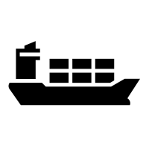




60 nm
5 nm

Slide 7

 |  | Course and speed |  | Monitoring of environment | Fallback when automation fails | Automated system in control
0 | No automation
1 | Driver assistance
2 | Partial automation
3 | Conditional automation
4 | High automation
5 | Full automation

Slide 8








Information
Decision
Action
Manned ship
Remote ship
Automated ship
Autonomous ship

Slide 9
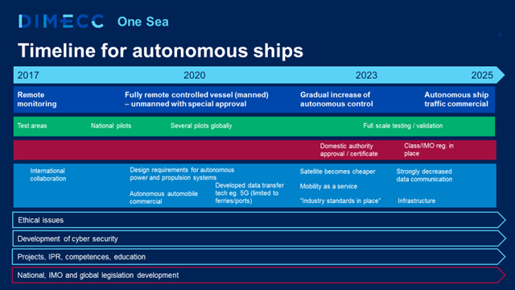
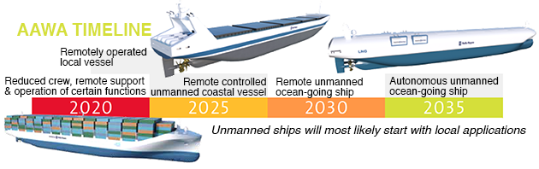
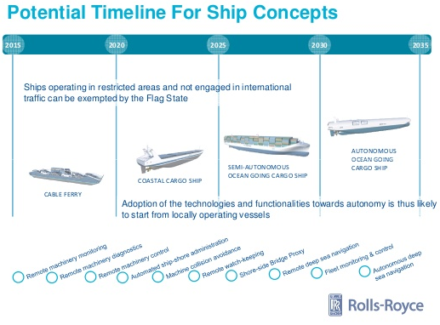
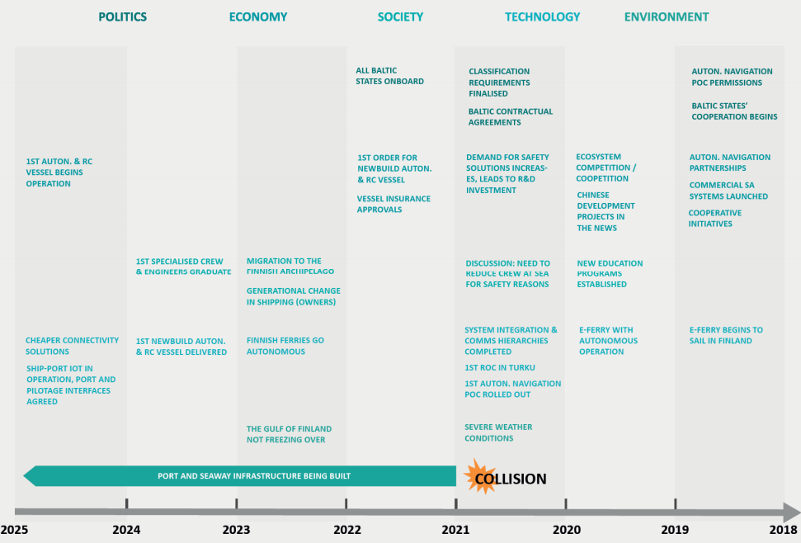
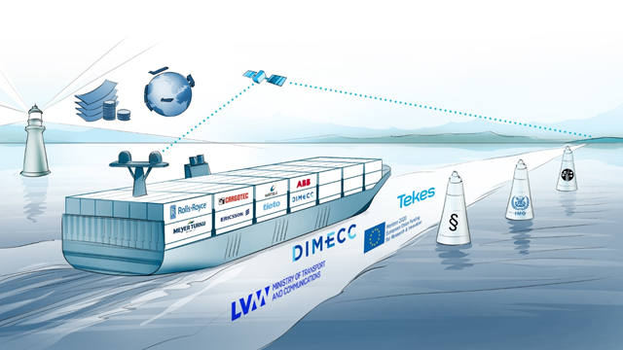

Slide 10
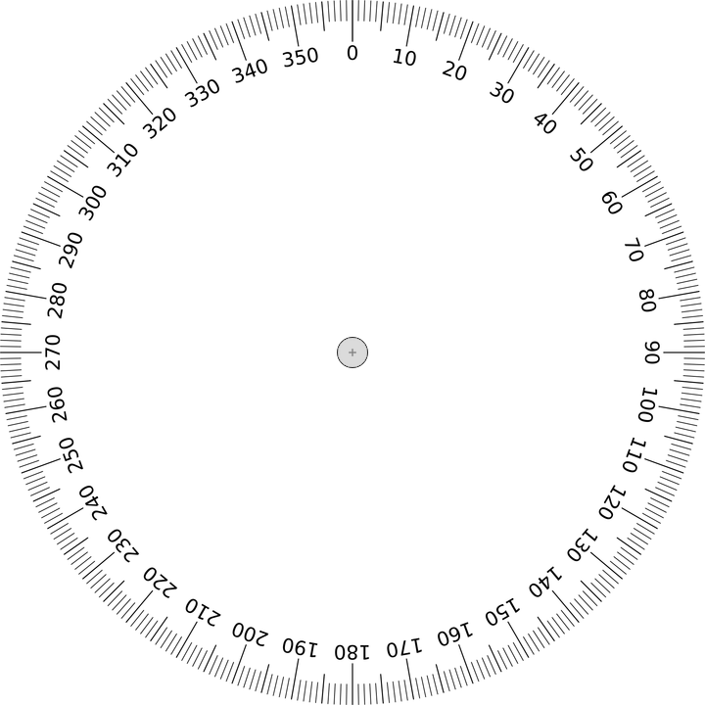
C
B
D
A

Slide 11
Tactical diameter
90° Advance distance
Steady diameter
β

Slide 13
δ

Slide 14
Side distance (Y)
θ
Distance till initial CPA (X)

Slide 15
Location other vessel
Steer to:
Port
Starboard
Collision point

Slide 16
Location other vessel
Steer to:
Port
Starboard
Collision point

Slide 17
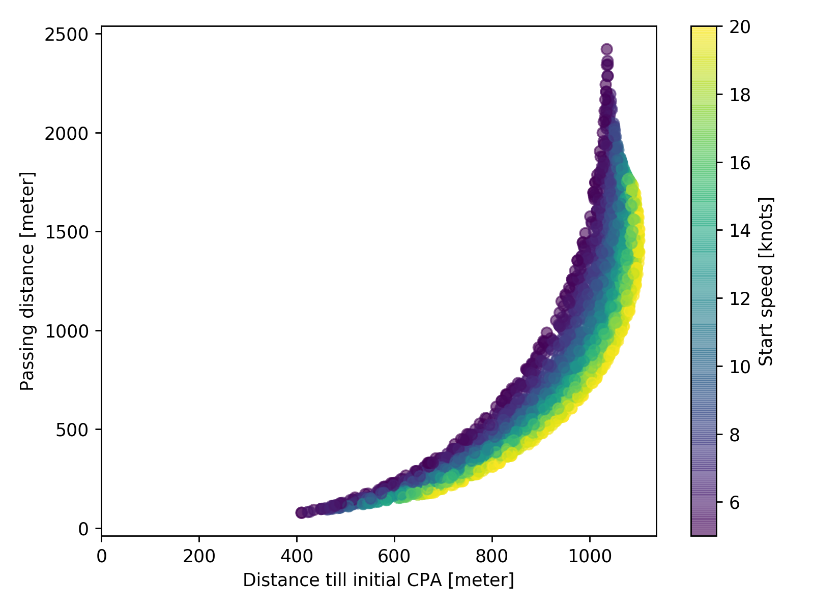

Slide 18
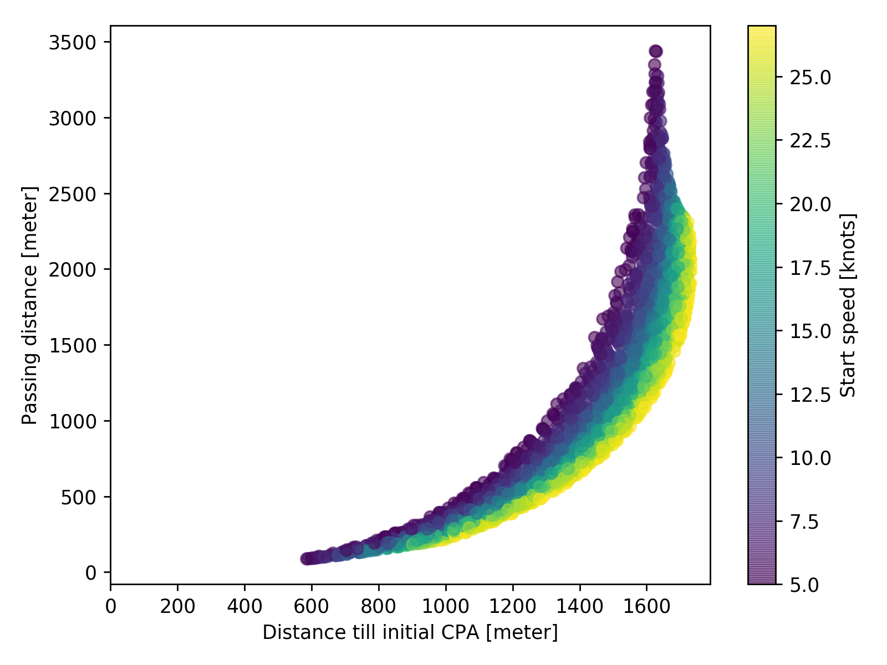

Slide 19
Advance distance (speed, manoeuvrability)
Speed other vessel
Passing distance
Maximum course change
Distance till initial CPA

Slide 20
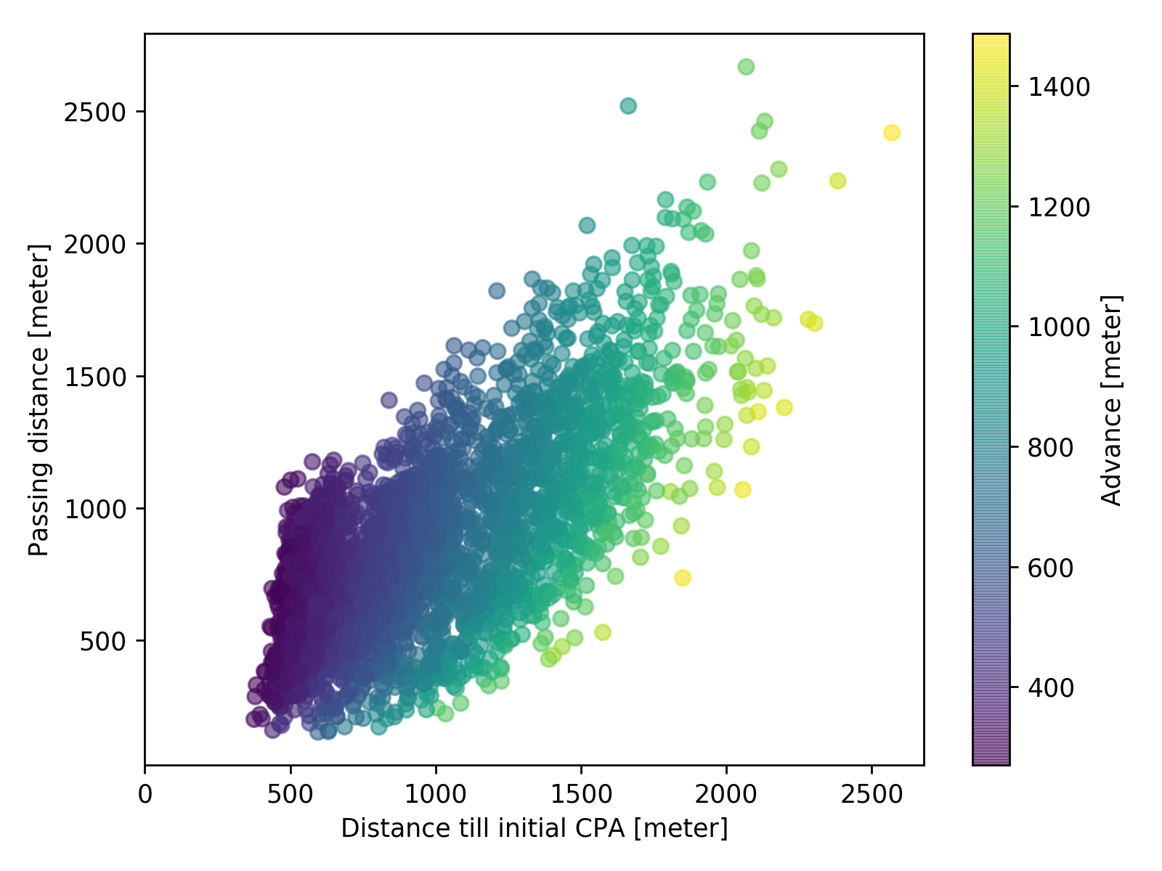

Slide 21
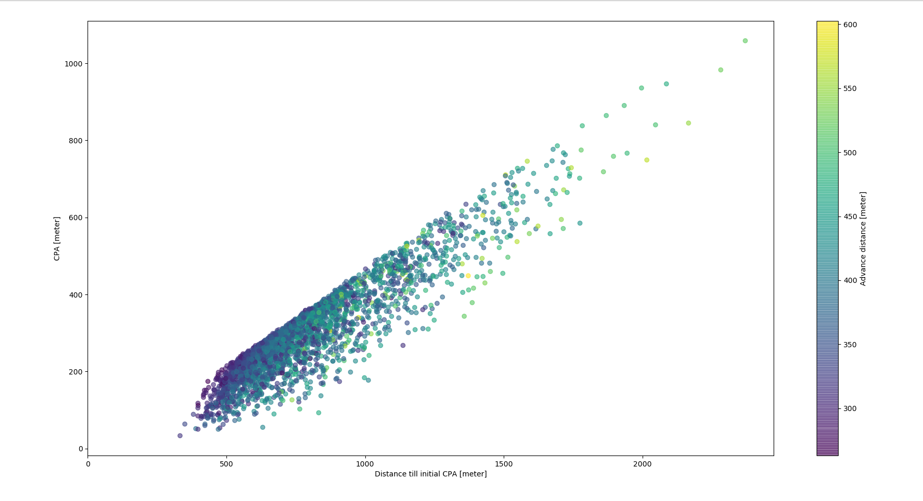

Slide 22
8+ years of experience
5 years of experience
1 year of experience
Partly autonomous
Remote operation
Full autonomy
Master
Officer in charge
Chief mate

Slide 24


Dover
Maasgeul

Slide 25
Dover
Maasgeul

Slide 26
Maasgeul
Dover

Slide 27



Slide 28
Nomoto
Least changes
Physically possible
Comfortable change
Expected route
MT
Manoeuvring
Capability
DWT, L, B, Speed, ...
COLREGs
Local
Marin
Area with initial probability
CS
Situation Awareness
Regulations
Well-clear
Safe motion parameters
t, X, Y, P
Dynamic
Probability index
Decision making
Szlapczynski
course, speed
Heatmap
Highest probability
Test with
Seafarers using tool
Advise crew using tool
VHF & AIS
Iterate map for every timestep
Other vessels summarized and seperate
Predicted capability envelope
Protocols
Routeplanner
Simulate
Possible decisions
Communication
Filter low probabilities
Hazards
Where is what ship (closest point of approach)?
In practice
Filter situation
Information available at bridge
Validate by testing tool
Talk with seafarers
Regulations &
Education
TSS
Map/radar
Shared
Static objects
No implementation
Only specific cases
Mental model
Instruments
Parameters
Usage
Master & other crew
Regulations
Implementation
In practice based on seafarers
Model of thoughtproces, with general considerations

Slide 29
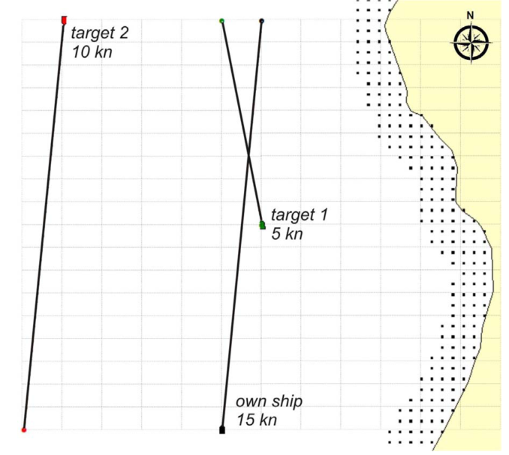

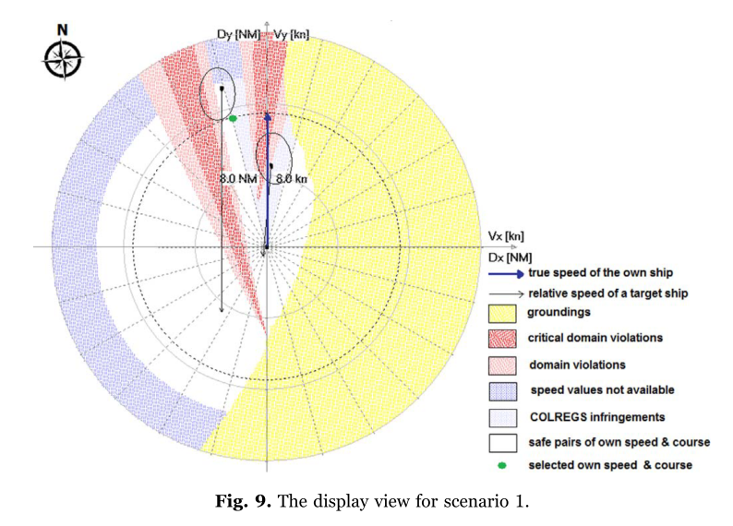
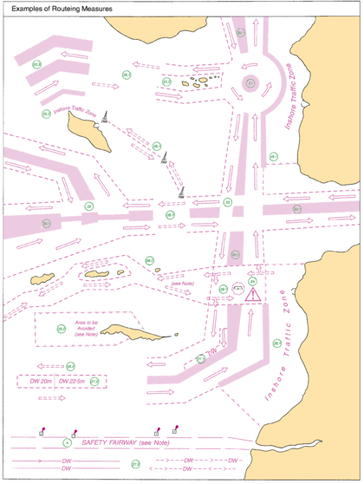
Szlapczynski
Heatmap own vessel
Safe motion parameters
Heatmap others
T = 5 sec
T = 30 sec
T = 60 sec
Traffic Seperation Scheme

Slide 30
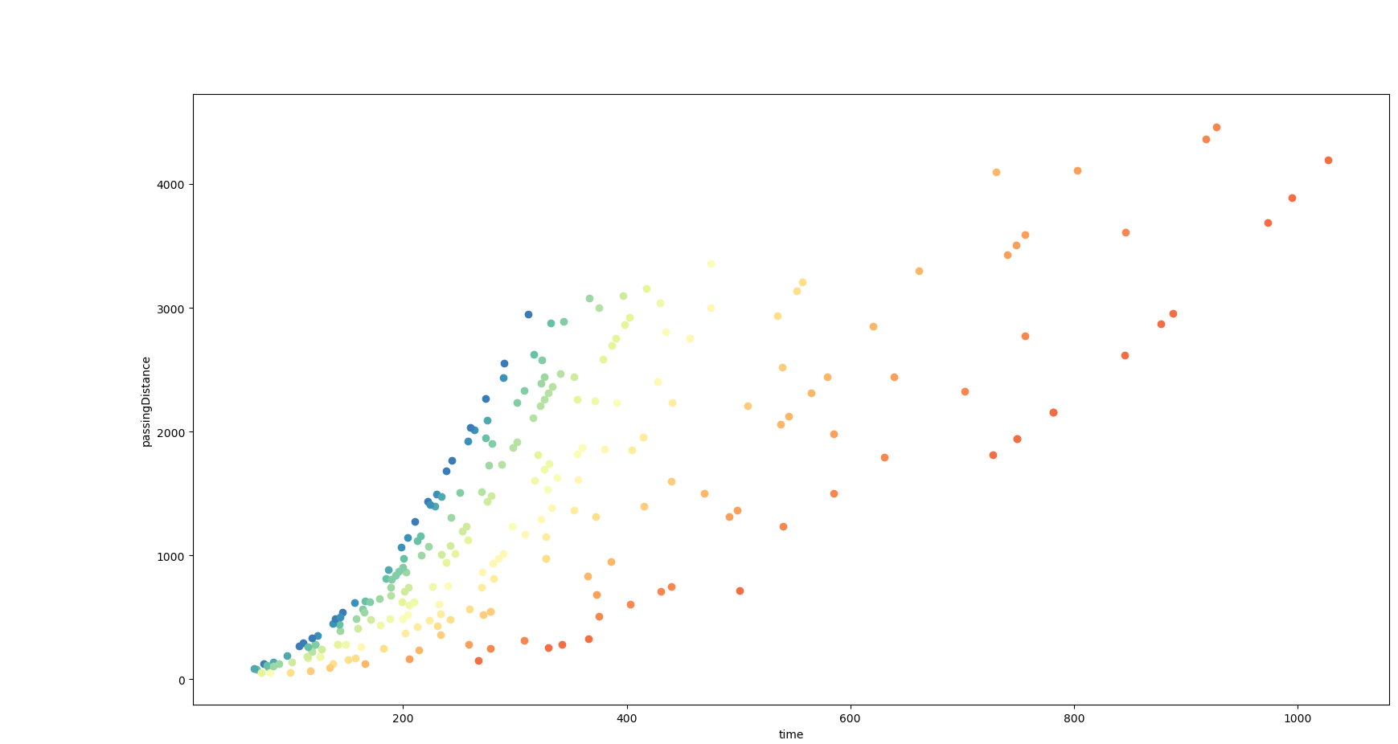
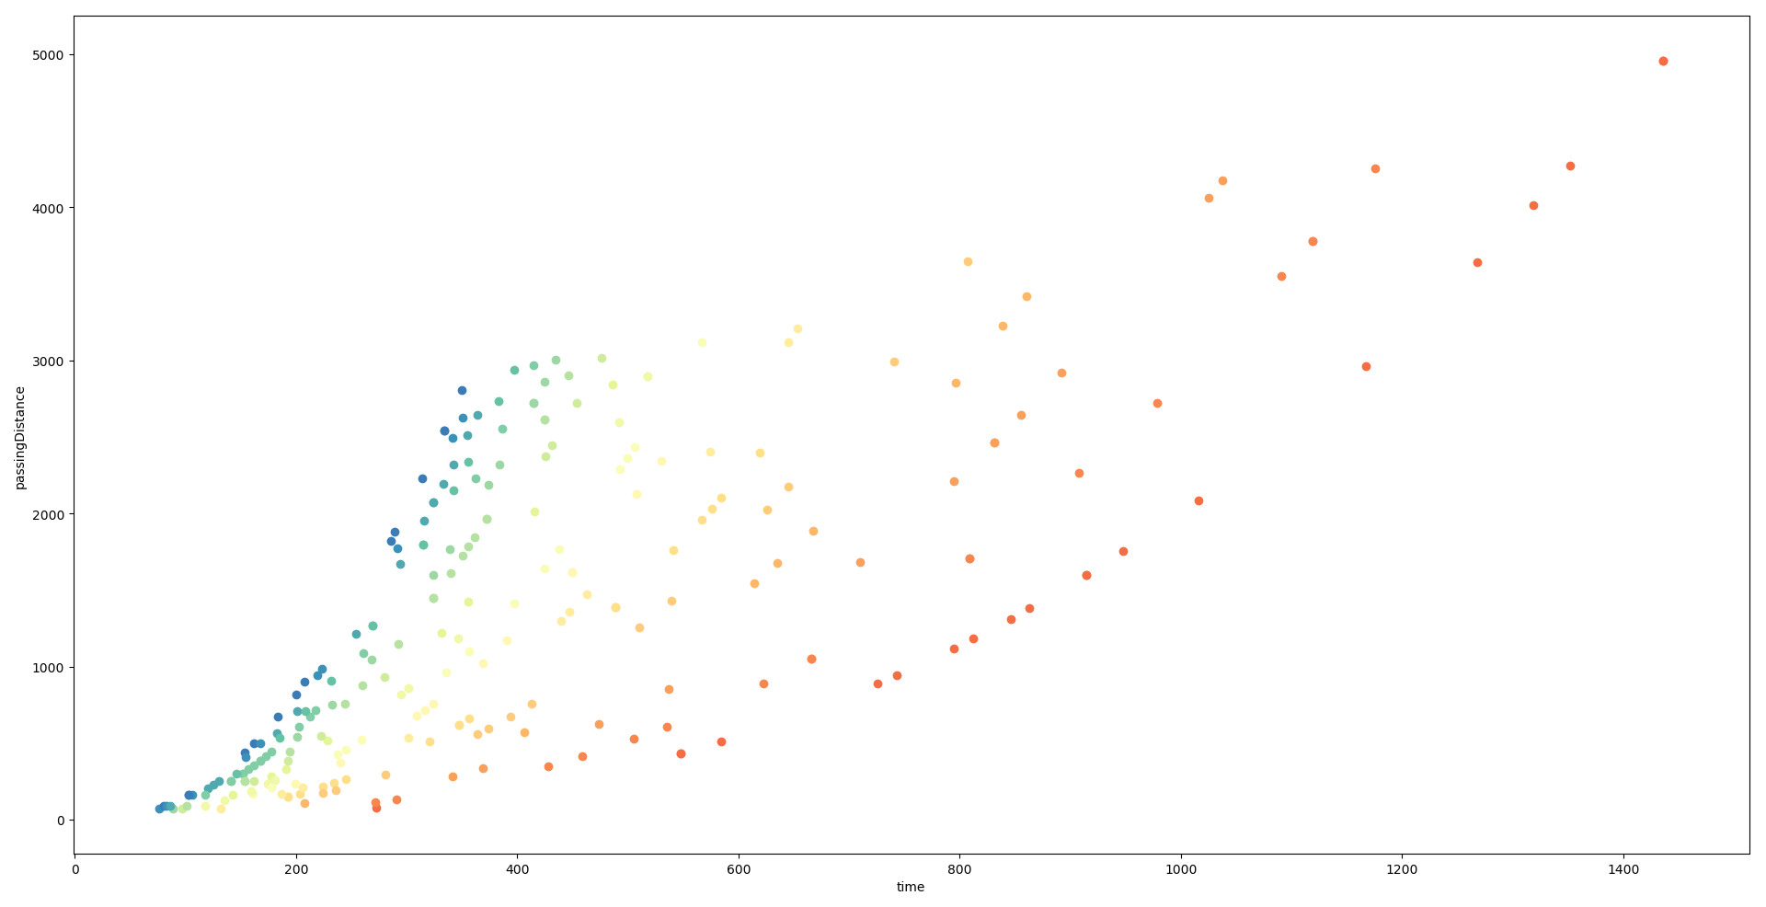
Gulf valour (250m)
Emma maersk (397m)

